Slide 1





International University - VNU HCMC
Final Project - (2024 - 2025 Semester 01)
IT069IU - Object-Oriented Programming
Tetris Game
Presented by: DNAT Group

Slide 2
About our group
Le Vo Hong Na - ITITSB23007
Pham Quang Tuong - ITDSIU20108
Nguyen Nhat Anh - ITITSB23006
Nguyen Nhat Duy - ITITWE22143

Slide 3
Presentation Structure
Introduction
What is Tetris game
UML diagrams
Classes
Tetris objects
How to create the Tetris shape
How to play the game
Demo video

Slide 4
Introduction
This is our OOP final project - a Tetris game
This project demonstrates key OOP principles that we have learned in this OOP course like encapsulation, inheritance, and polymorphism.

Slide 5
What is Tetris game
Tetris game, which was created in 1984 by Alexey Pajitnov, is a classic puzzle game genre associated with many generations.
When a line is successfully formed, it disappears, and the player earns points. As the game progresses, the falling blocks increase in speed, adding to the difficulty and excitement.

Slide 6
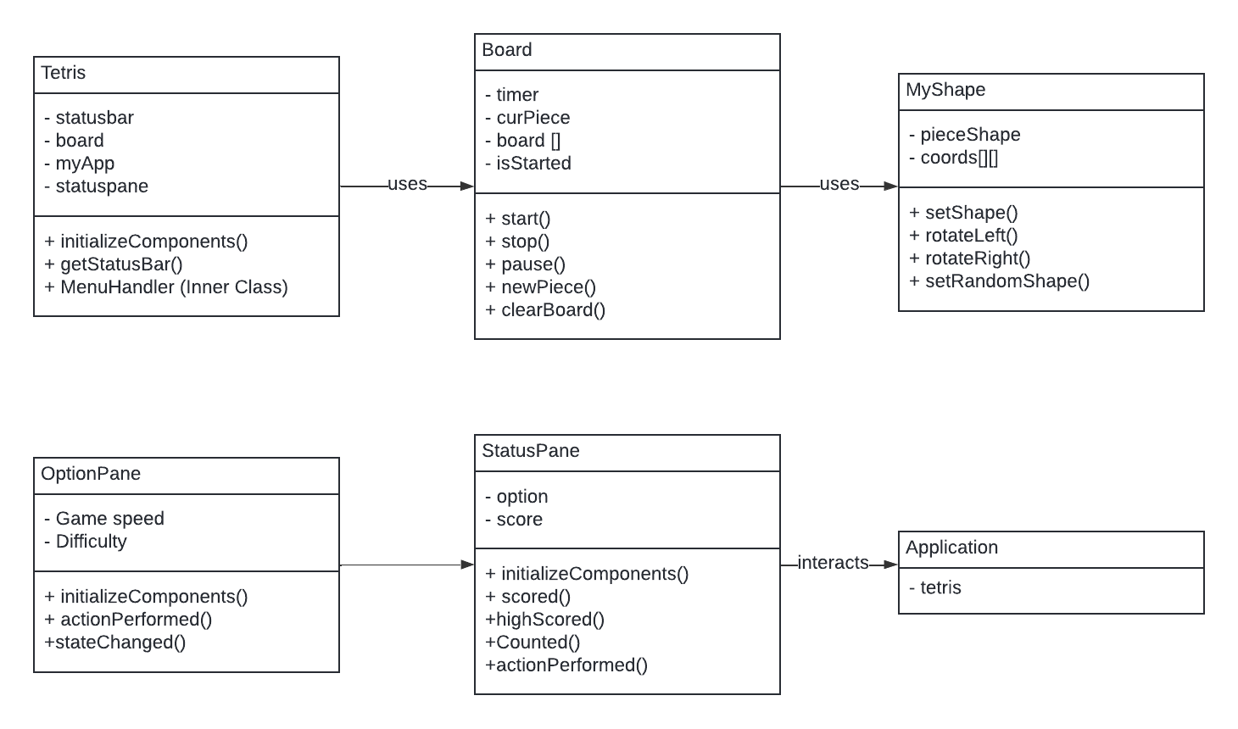
UML diagrams

Slide 7
Classes
Tetris.java: Create the frame to add the game’s panels
Board.java: Use to control the game:
Remove the full-line and calculate Score and HighestScore
Make grid for the game plane
Allow play game from the keyboard
Add color for the shapes
Create random shapes
Clear the board when click Start game
MyShape.java: Use to create the Tetris shapes

Slide 8
Classes
StatusPane.java:
Create the Start Game and Setting buttons
Show Score, Highest score and removed lines on the screen
OptionPane.java: Show the interface of the Setting button to adjust the game speed and difficulty
Application.java: Run the game

Slide 9

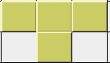
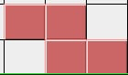
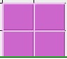
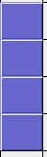
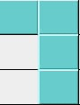
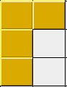
Tetris Objects
Normal level:
7 basic kinds of shapes:

Slide 10
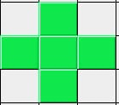
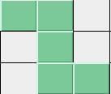


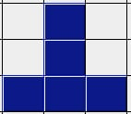

Tetris Objects
Hard level
Extreme level

Slide 11
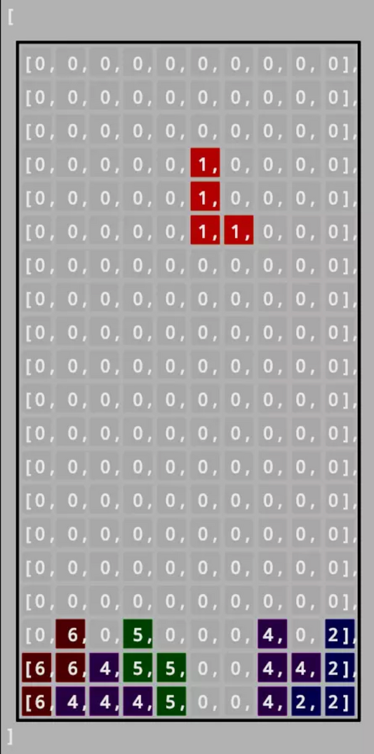
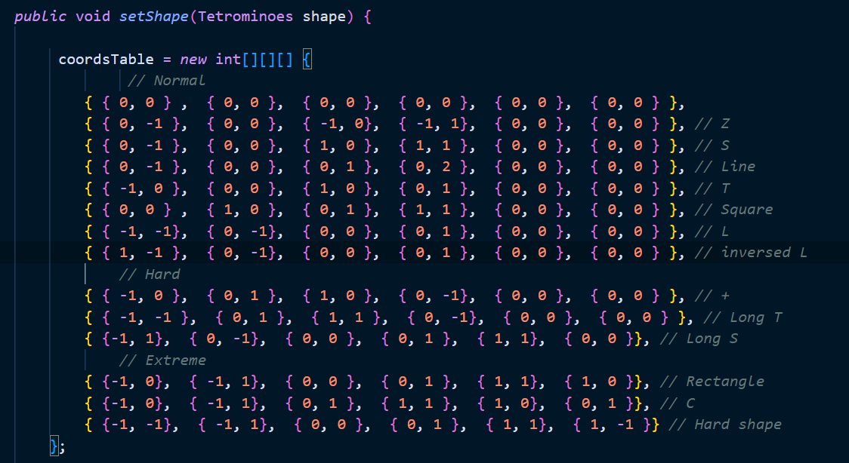
Create the shapes

Slide 12
How to play
Step 01: Click Start game to begin the new game
Step 02: Using your keyboard to operate the shapes
“S” key: Increase the shapes’ speed
“P” key: Pause the game
Space key: Drop the shapes immediately
Arrow key: Rotate the shapes to fit

Slide 13
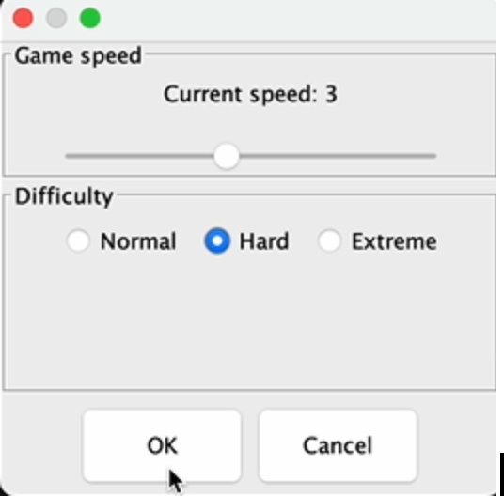
Besides, you can also use the Setting to adjust the speed and difficulty, and click OK to save your choice.

Slide 14
Demo video

Slide 15
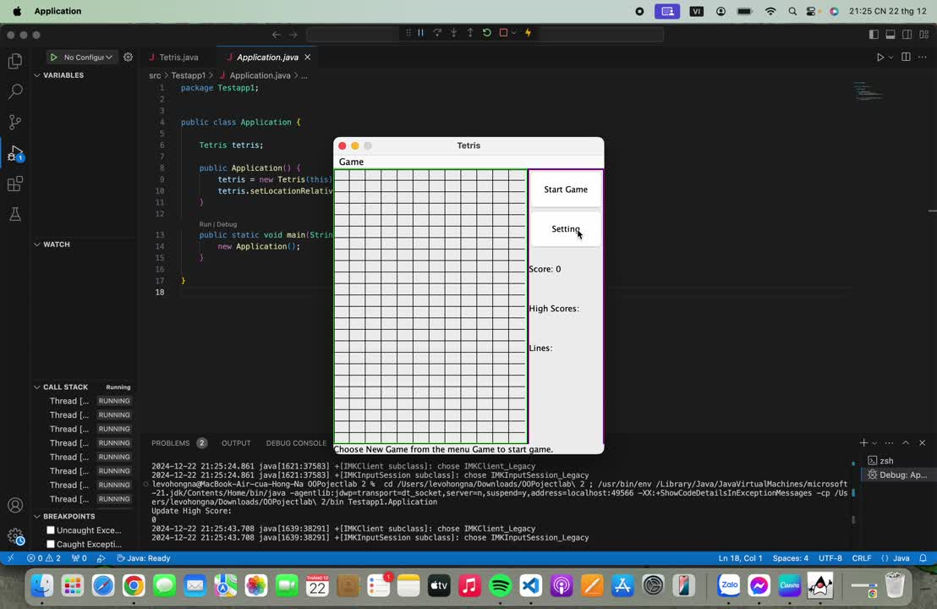

Slide 16
Thank you
for listening

